Slide 1

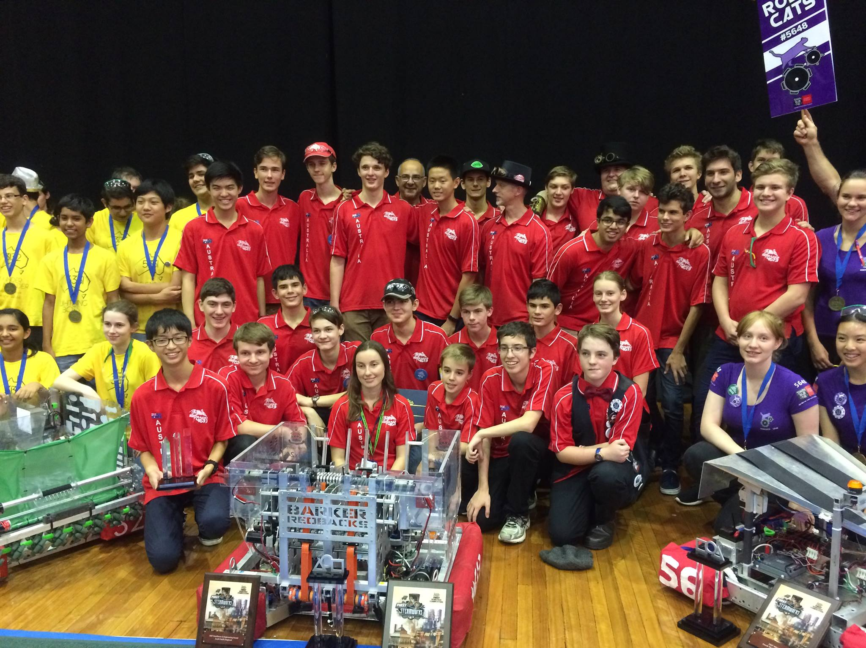
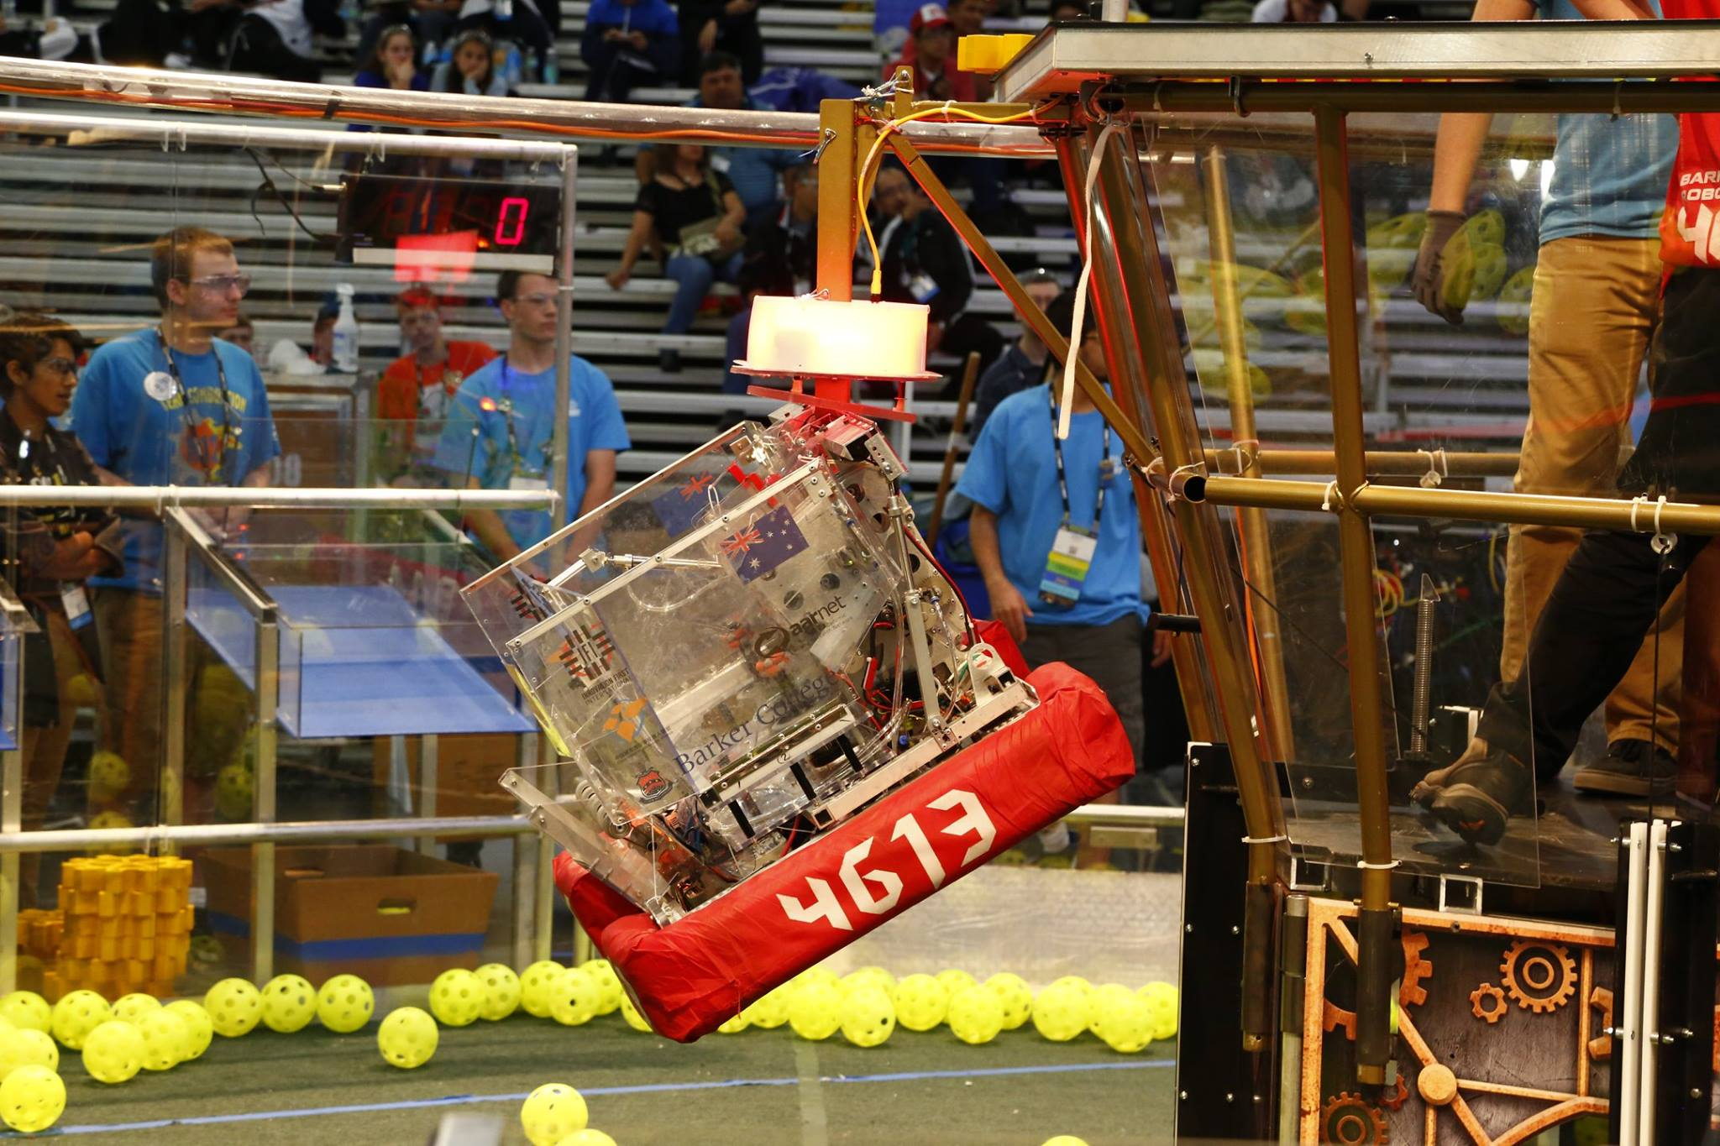
Introduction to (Java) Programming – 1 - Introduction
Tom Schwarz

Slide 2
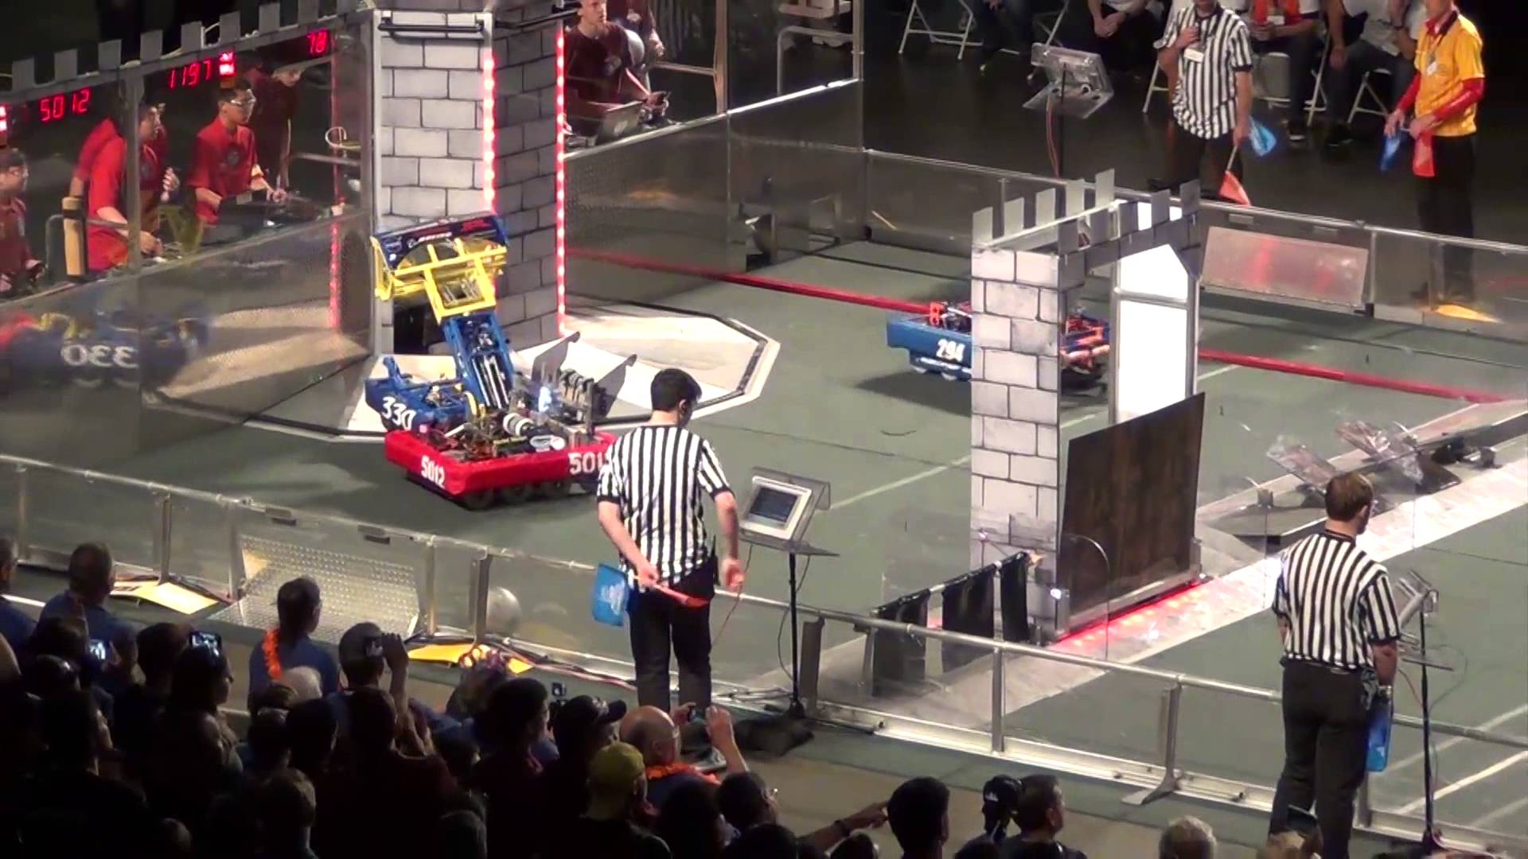
What is FIRST/FRC/4613?
FIRST - US organization, which runs…
FRC (FIRST Robotics Competition)
One of four competitions run by FIRST
At the beginning of the year, the game is announced in the kick-off
For ~six weeks teams can work on their robot before it must be bagged
After that are seven weeks of regional competitions, which then are followed by the world championship
Barker also competes in FTC with middle school robotics and FLL in the junior school
4613 / Barker Redbacks – Barker’s FRC robotics team, which you are joining!

Slide 3
Some example robots/games!
2015 – FRC regional semi final - https://www.youtube.com/watch?v=lJuM-XNxk2I
2016 – 4613 Robot Reveal - https://www.youtube.com/watch?v=lDf-Jwn42XY
2017 – Hopper division QF2M2 - https://youtu.be/1waoIDdQ36A
2017 – 118 Robot Reveal - https://www.youtube.com/watch?v=x6CtdZ91qzI

Slide 4
Subteams!
Mechanical subteam
Involved with prototyping, desigining and manufacturing the robot mechanical components (e.g. drivetrain, superstructure, shooters)
Programming subteam
Involved with making the software to power the robot (unbelievably)
Problems to solve include:
Vision tracking
Moving motors and components into correct position at correct speed as fast as possible (actually gets really hard)
Autonomous – game starts with 15s period where robot driver autonomously.

Slide 5
Subteams - 2!
Scouting/Strategy
Analyses game to decide what the robot should do to effectively score points
In most games you can score in multiple ways. Have to decide best way to score.
Records and analyses data at events to create strategy at events and determine what the robot should do that match
Media
Videos you watched don’t just create them self!
Videos important for outreach, expanding, and sponsorship

Slide 6
Now time for actual programming!
Go to: https://team4613-barkerredbacks.github.io/Programming-Java-Guide/
Website is guide created to explain programming concepts
Can be done at home if you miss a workshop or something.

Slide 7
Lesson 1: Introduction to Programming
Programming languages
Allow people to give computers instructions in a way both can understand
Most languages share similar concepts
Syntax
Syntax is the structure of how code is written
Computers can’t infer things very well, and so like a very strict set of grammar rules. (The rules are called syntax).
Compilers
Compilers convert your complex, semi-English code into detailed instructions for a computer

Slide 8
Lesson 1: Introduction to Programming
Set up – detailed instructions on website, but:
Install Eclipse from eclipse.org – alternatively get if off the passed around USB
Create a Github account and let us know so we can add you to our organization
Download and install Github Desktop
While things are installing, you can:
Read through the first lesson on the website. Goes through stuff in a bit more detail!
Move on to the second lesson, where you start writing code.

